Slide 1
Project Presentation

Slide 2
Introduction

Slide 3

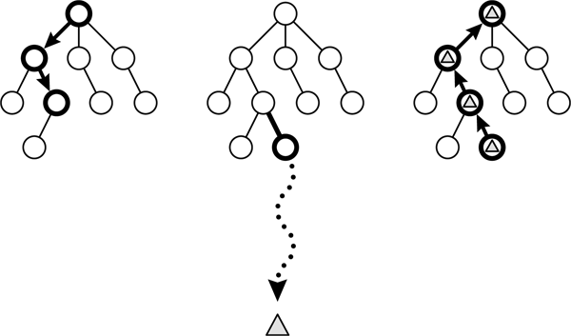

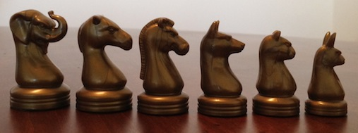
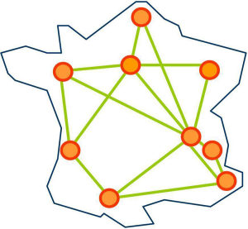

Project Presentation
Fast and Furious Game Playing,
Monte Carlo Drift
Project goals :
Build an Artificial Intelligence for
2 players strategy boards Game
Use the MCTS algorithm
Apply it to games
Parallelize the algorithm
Apply it at Grid'5000, IRISA
MCTS algorithm
Arimaa
Notes:
Here is the presentation of our project. Our purpose will be to build an Artificial Intelligence for a 2 players strategy board game, but not entirely solved like checkers, or Dames in French, but not to much studied like Chess.
For our Artificial Intelligence, we will use the MCTS algorithm, a very knowed algorithm able to calculate one of the best moves to play. The MCTS algorithm don't guess all moves possible, it just select the best moves and develop them, to see where they leads. Then, it computes statistics to make it possible to select a move.
Then we will apply the algorithm to game, beginning by simple one like TicTacToe, or Morpion, and Connect 4, or Puissance 4. Then, we will apply to the non solved game Arimaa, similar to Chess when we see the board, but with so much possibilities it is impossible to solve it with a computer.
We will choose away to compute the tree of moves, between different types of parallelization.
To improve the power of our computation, we will run it using CPU parallelization of our computers, then GPU parallelization on our graphical card of our computers, and Finally in Grid'5000, The cluster of computers handled by the IRISA.

Slide 4
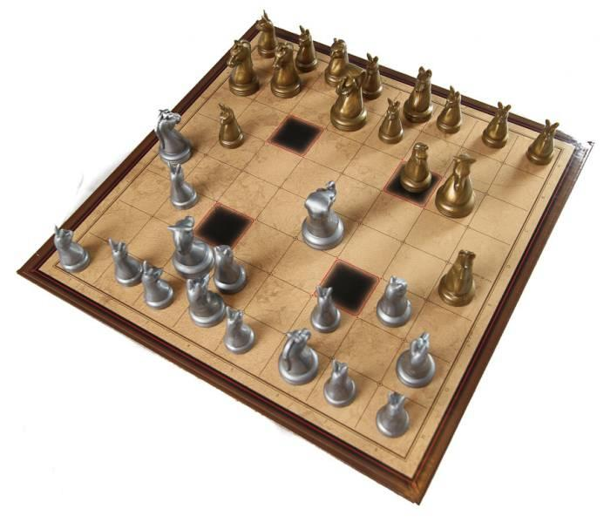
Arimaa : the Game
Plays on a chess board
Follows simple rules
Difficult to play for artificial intelligence
Unlike for chess, no algorithm running on a modest personal computer can best the human champions

Slide 5
The rules: Basic rules
Each player starts off with 16 pieces, as follows :
Each player disposes of 4 moves per turn
A win is achieved by having a rabbit reaching the opposite side of the board

Slide 6
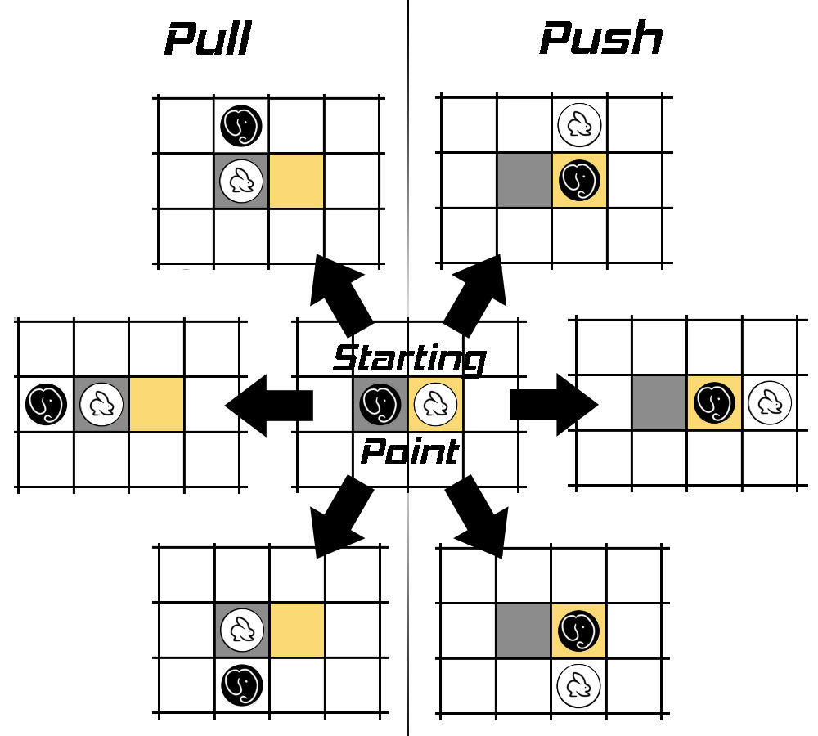
The rules: Displacement
Any piece can push or pull an adjacent enemy piece, if said piece is weaker.

Slide 7
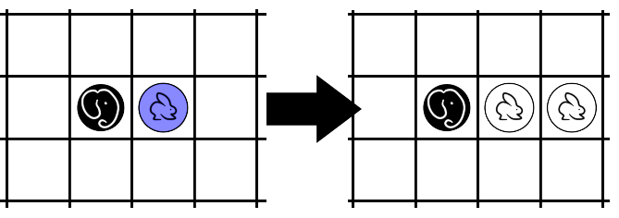
The rules: Freezing
A piece standing next to a stronger enemy piece cannot move unless there is an ally piece beside it.

Slide 8
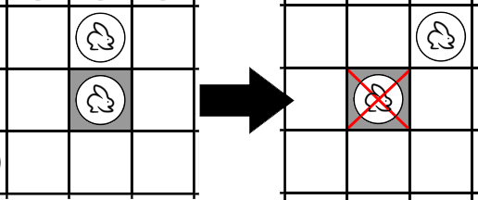
The rules: Traps
Each piece standing on a trap dies, unless there is an ally piece beside it.

Slide 9
MCTS algorithm

Slide 10
Parallelization methods

Slide 11
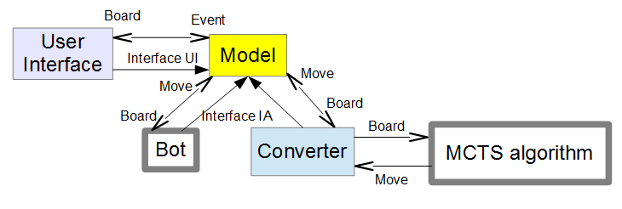
General Architecture
General view module
5 modules:
User Interface
Model
Converter
MCTS algorithm
And eventually a Bot
Notes:
In this part, we are going to study the General Architecture.
Here is the general architecture diagram. We can see the 5 modules interacting with each other.
The User Interface interacts with the environment generating events handled by the model. This module interact with the Artificial Intelligence.
In our project, it will be the MCTS algorithm, connected together thanks to a converter.
But by implementing a single interface, it will be possible for the model to interact with a bot, an other one Artificial Intelligence created by other people. Then, it will be possible to use a bot from the site Arimaa.com

Slide 12
General Architecture
User Interface module
User Interface:
Communication with the player:
menu mode
the game
Send the events to the Model
Notes:
Let's see what is in this modules. The first module is the User Interface, which communicate with the player via the menu mode, and the representation of the game, the board. It will create events, and send them to the Model, to be treated.

Slide 13
General Architecture
Model module
Model:
Handle the game itself
Containsthe board
Contains the rules
Call the AI
Notes:
The model will contains the game itself. What is the game here.
It will be the board, the place of all pieces, but the rules as well.
It will be able to call the Artificial Intelligence via the converter.

Slide 14
General Architecture
Converter module
Converter:
Interface
Convert data flux between the Model and the MCTS algorithm
Notes:
The converter module is a simple interface that makes interact the Model and the MCTS algorithm module. It will send the state of the board in this sense, and send the correct move in the other sense.

Slide 15
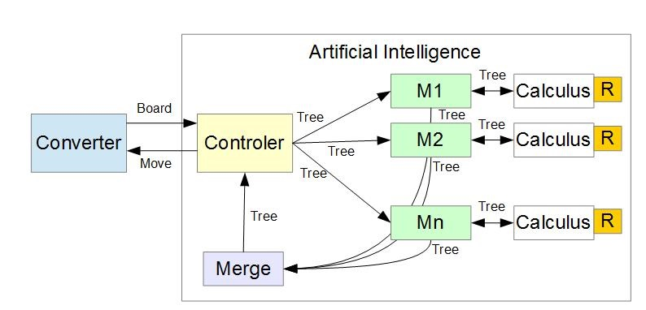
General Architecture
MCTS algorithm module
MCTS algorithm:
Parallelization:
Dispatching of data in
different threads
Calculus of moves
Set of rules
Merging the results
The controler sends the move
Notes:
The MCTS algorithm

Slide 16
Specifications

Slide 17
Chronology

Slide 18
Conclusion

